Slide 1


Music Genre Classification (Spotify Dataset)
Hardik Gupta
(M13474715)

Slide 2

Contents
Problem Statement
Dataset
Approach
Audio features and Genres
Correlation between features
Correlation between genres
Modelling
Linear Discriminant Analysis
Decision Trees
Random Forest
Conclusion

Slide 3

Problem Statement/Purpose
Problem Statement
Categorizing songs according to their genre, using certain audio features provided by Spotify.
Why?
Instantly classifying songs helps music service providers to curate playlists and recommend it to their users based on personal preferences.
Proposed Solution
Build a classification model using various machine learning techniques for accurately predicting the genre of music.

Slide 4

Dataset
This data comes from Spotify via the spotifyr package. Charlie Thompson, Josiah Parry, Donal Phipps, and Tom Wolff authored this package to make it easier to get either your own data or general metadata arounds songs from Spotify's API.
This dataset was uploaded on GitHub as a part of TidyTuesday by R community, which was created to provide individuals with datasets to practice R skills.
There are total 32833 observations in 23 variables.
There are 12 audio features for each track, including confidence measures like acousticness, liveness, speechiness, instrumentalness, and perceptual measures like energy, loudness, danceability, and valence (positiveness), and descriptors like duration, tempo, key, and mode.

Slide 5

Approach
Analyze the data to understand which variables would be most suitable for prediction.
Use visualizations to analyze audio features, and their relationship with each of the genre in the dataset.
Isolate features which are most suitable for individual genre classification, since not all audio features will be relevant to every genre.
Check correlation amongst audio features to remove any redundant features.
Explore correlation amongst various genres.
Use of machine learning algorithms like Random Forest and Linear Discriminant Analysis.
Single out the best performing model.
*will explore more options(ml techniques) as I proceed with the project and might make new additions/modifications to the dataset

Slide 6

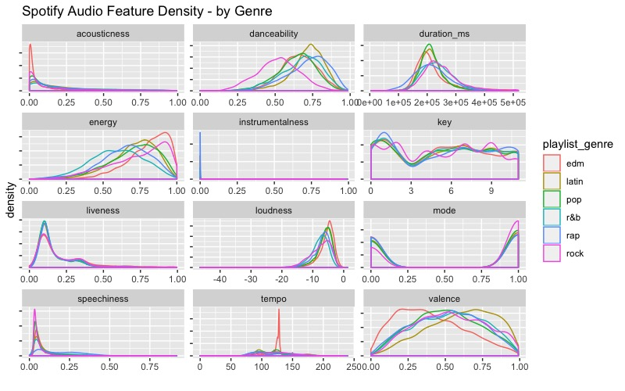
Audio feature and Genre
Here we explore each of the audio features and how it relates to the 6 genres in our dataset.

Slide 7
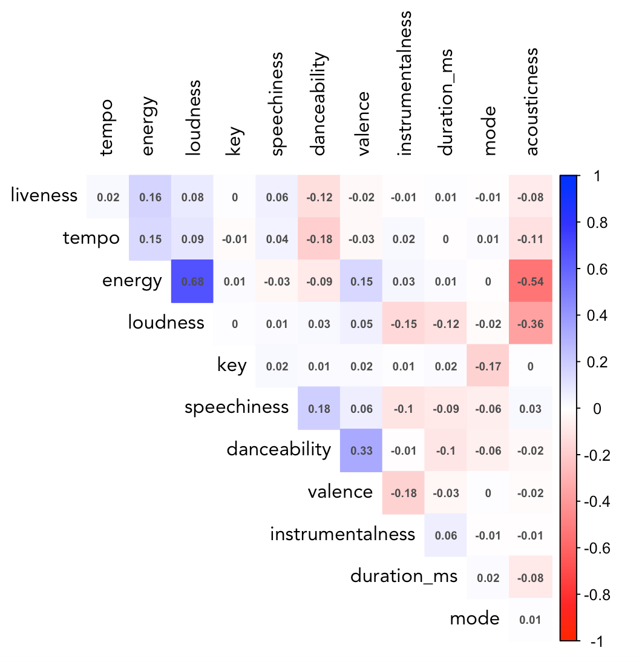
Correlation between features
The plot below shows the correlation between each of the audio features.

Slide 8

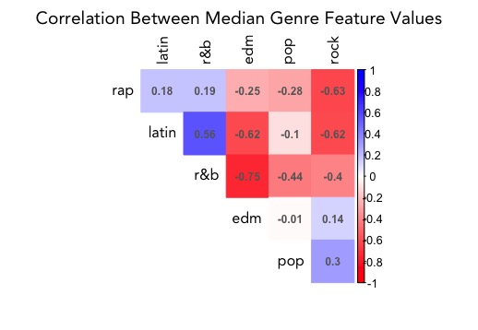
Correlation between genres
The plot below shows the correlation between each of the genres.

Slide 9
Modelling
As per the insights gained from Exploratory Data Analysis, we have decided to use the following variables and models for our predictions.
Variables:
Valence
Danceability
Tempo
Energy
Speechiness
Models:
Linear Discriminant Analysis
Decision Trees
Random Forest
For our modelling purpose we have split our dataset in Training (80%) and Testing Set(20%).

Slide 10
Linear Discriminant Analysis
As the results above indicate, EDM, Rock, and Rap were the most easily separable genres.
We got a misclassification rate of 58%

Slide 11
Decision Trees
Most important feature in the tree is Speechiness, separating Rap from the rest of the Genres.
High Tempo tracks are either classified as EDM or RAP with higher tempo songs being classified as Rap.
Best classification was achieved for EDM with 56% correctly classified and second best was Rap with 46%.
Overall we got an accuracy of 37% from decision trees.

Slide 12
Random Forest
We ran a random forest with 100 trees.
And, got a classification rate of 49%, which is the best amongst all the 3 models.

Slide 13
Conclusion
Random Forest had the best classification rate.
If we guessed randomly which genre to assign to each song in this dataset, the accuracy would be 16.6% (or 1 in 6).
The decision tree improved on random chance twofold, and LDA and Random Forest improved it slightly more than threefold.
Classifying fewer genres would likely improve this metric and trying to classify more than 6 would likely drive it down further.
It's unlikely that this approach is a robust way to classify music in real life.

Slide 14
That’s it for now.
Thank You ☺

